Slide 1
Research Seminar – Question Suggestion in Financial Institutions
St.Gallen, 11th March 2026

Slide 2
Proposed research question & hypotheses
Generic question (allocated)
Do demographics affect bank funding?
Specific question (to be defined)
Population Aging and Bank Deposit Funding: The Role of Financial System Structure
Hypotheses
H1: The positive effect of population aging on retail deposit funding is stronger in bank-based financial systems than in market-based financial systems
H2: A higher share of the very old population (85+) is associated with higher retail deposit funding, regardless of the financial system structure

Slide 3
Overview of the economic intuition
Well known from literature
Our research contribution
H1
Older households have lower risk tolerance due to shorter investment horizons
Higher demand for safe assets as result
Households rebalance portfolios toward low-risk assets
Bank-based: Safe assets = bank deposits Market-based: Safe assets = govt bonds, bond ETFS, …
In bank-based systems: Deposits increase In market-based systems: Deposits increase less or not at all
H2
Very old households face estate planning; want to simplify portfolios, ensure liquidity for healthcare costs, make inheritance easier
Complex assets (e.g., stocks, funds, private investments, …) are gradually liquidated
Wealth moves into the simplest liquid accounts (i.e., bank deposits)

Slide 4
Academic papers supporting the theory (1/2)
Household portfolios (Guiso et al.)
Life cycle model (Danziger et al.)
Household Finance (Campbell)
Financial systems
Topic
Theoretical & empirical analysis of household portfolio structure
Consumption Behavior of the Elderly in the Society
Theoretical & empirical analysis of household portfolio structure
Bank-based vs. market-based financial systems
Year
2002
1982
2006
2002
Journal
Book
Journal of Post Keynesian Economics
Journal of Finance
Journal of Financial Intermediation
Key findings
Older households systematically shift wealth toward safe assets
The elderly save more than the young people
Older households allocate a larger share of their portfolios to safe and liquid assets
No system is superior for economic growth
Supports H1 on broad level
Supports H1 specifically, indicates support for H2
Mainly supports H1
Helps to distinguish between systems (H1)

Slide 5
Academic papers supporting the theory (2/2)
Strongly supporting & recent
Population ageing & bank risk taking (Doerr et al.)
Banking on demography (Doerr & Kabas)
Demographics & structure of bank BS (Avramidis & Pennacchi)
Bank-based system growth (Beck et al.)
Topic
What are the impl. of an aging population for financial stability?
Impact of ageing population on banking sector
Impact of ageing on bank A/L
Financial intermediary and private saving rates
Year
2022
2019
2025
2000
Journal
BIS Working Paper
N.a.
Journal of Money, Credit, Banking
Journal of Financial Economics
Key findings
Areas with more elderly people experience higher bank deposits
A 10% increase in the elderly population increases bank deposits by about 4.6%
Banks in older regions rely more on retail deposits and less on wholesale funding
Bank-based financial systems rely heavily on deposits as the main savings channel
Strong support for H1
Strong support for H1
Strong support for H1
Supports intuition behind H1 split by system

Slide 6
Academic papers on pension systems & classification (1/2)
Addio et al.
Scharfstein
Caloia et al.
Topic
Pension & household savings cross-country analysis
Pension Policy and the Financial System
Household savings & shocks to occupational pension funds
Year
2020
2018
2025
Journal
ECB Working Paper
Journal of Finance
Journal of Pension Economics & Finance
Key findings
Strong public pensions → lower need for private retirement savings
Countries with large private pension systems have larger capital mkts
When pension funds become weaker, HH increase private savings
Supports to include pension system as control
Makes strong argument to include pension system
Supports to include pension system as control

Slide 7
Academic papers on pension systems & classification (2/2)
Bottazzi, R., Jappelli, T., & Padula, M.
Alessie, R., Angelini, V., & van Santen, P.
Duplicate
Scharfstein, D. S.
Topic
Retirement expectations, pension reforms, and their impact on private wealth accumulation
Pension wealth and household savings in Europe: Evidence from SHARELIFE
Presidential Address: Pension policy and the financial system
Year
2006
2013
2018
Journal
Journal of Public Economics
European Economic Review
The Journal of Finance
Key findings
Pension generosity can substitute for private wealth especially among informed households
+1 EUR increase in pension reduces private wealth by -0.47 EUR, implying that pension substitutes savings
-) Higher pension replacement rates tend → more bank-based financial systems
-) households hold more deposits as a share of wealth in more PAYGO-oriented system
Supports using replacement rate as proxy for pension generosity
Uses pension wealth as a measure which takes replacement rate into account
Direct link between financial systemstem & pension type

Slide 8

Literature review paper

Slide 9


Datasets which may be used
Provided CSV file
Demographic data
Market structure classification
Pension system classification
Pot. replace
Sources
Dependent Variable:
Total Deposits
Total Assets
Control Variable:
Total Net Loans
Total Equity
Total Assets
Net Income Before Taxes
World Bank: https://data.worldbank.org/indicator/SP.POP.65UP.TO.ZS
US Census Bureau: https://www.census.gov/data-tools/demo/idb/#/dashboard?dashboard_page=country&COUNTRY_YR_ANIM=2026
Stock market cap:
https://data.worldbank.org/indicator/CM.MKT.LCAP.GD.ZS?utm_source=chatgpt.com
Private credit:
https://data.worldbank.org/indicator/FD.AST.PRVT.GD.ZS?utm_source=chatgpt.com
Stock market cap:
https://data.worldbank.org/indicator/CM.MKT.LCAP.GD.ZS?utm_source=chatgpt.com
Pension fund assets:
https://databank.worldbank.org/source/global-financial-development/Series/GFDD.DI.13
Core dataset with dep./indep. variables
Key data on demographics across countries
Enables classification of main explanatory variable
Calculation of additional control variable

Slide 10
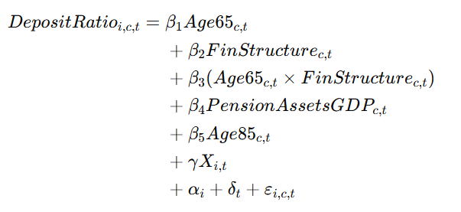
Components of the refined regression model
Regression component
Explanation
Baseline aging effect
Financial system structure effect
Aging effect depending on structure (interaction term)
Explanation on next slide why pension system should not be main explanatory variable
Pension system control variable
Very old population effect
Bank-level control variables (see next slides)
Bank & year fixed effects; error term

Slide 11
Financial system structure as the key explanatory mechanism
Pension system structure
Financial system structure
Key question
How much wealth needs to be accumulated for retirement?
Once wealth is accumulated, where are these savings allocated?
→ Affects and determines wealth accumulation
→ Determines if savings go to banks or markets
Mechanism
Determines retirement saving needs
Determines savings intermediation channel
Link to bank deposits
Indirect
Direct
Limitations
Does not determine asset allocation
Only indirectly affects bank deposit levels
Even if we know the levels of wealth accumulation depending on system, we still need to know where this wealth is allocated
Different measures exist
Evolvement of systems over time?

Slide 12
Additional considerations
1
2
Suitable controls from dataset
Pot. omitted variables
Bank size (Large banks rely more on wholesale funding)
GDP development If not controlled, the aging effect may actually capture economic development
Potentially to be controlled for to resolve omitted variable bias
Loan ratio (Banks with more loans need stable funding, which usually comes from deposits)
Interest rate environment Strongly affect deposit attractiveness
Equity ratio (Higher equity = less risk; hence less stable deposit funding needed)
Financial regulation -> Partly absorbed by bank fixed effects
Profitability (Profitable banks attract deposits due to stronger reputation)
Banking structure -> Partly absorbed by bank fixed effects

Slide 13
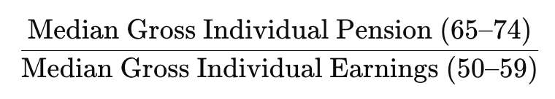
Controlling for pension systems: pension replacement rate
OLD
Definition
The aggregate replacement ratio is gross median individual pension income of the population aged 65–74 relative to gross median individual earnings from work of the population aged 55–64, excluding other social benefits
Formula
Datasets
European Union: 2010-2025
https://ec.europa.eu/eurostat/databrowser/view/tespm100__custom_20473233/default/table
https://ec.europa.eu/eurostat/databrowser/view/tespn070/default/table?lang=en
OECD 2013
https://www.oecd.org/content/dam/oecd/en/publications/reports/2013/11/pensions-at-a-glance-2013_g1g3404e/pension_glance-2013-en.pdf
OECD 2012
https://www.oecd.org/content/dam/oecd/en/publications/reports/2012/06/oecd-pensions-outlook-2012_g1g1aeb6/9789264169401-en.pdf
OECD 2011
https://www.oecd.org/content/dam/oecd/en/publications/reports/2011/03/pensions-at-a-glance-2011_g1g12126/pension_glance-2011-en.pdf
OECD 2009
https://www.oecd.org/content/dam/oecd/en/publications/reports/2009/09/pensions-at-a-glance-2009_g1ghab79/pension_glance-2009-en.pdf

Slide 14
Separating “where” and “how much”
Discussion
Pension system
Key question
How much wealth needs to be accumulated for retirement?
How much wealth needs to be accumulated for retirement given public “generosity”?
→ Affects and determines wealth accumulation
→ Affects and determines wealth accumulation
Mechanism
Determines retirement saving needs
Determines retirement saving needs
Link to bank deposits
Indirect
Indirect
Measures
Pension Assets / GDP
Replacement Ratio
Limitations
Proxies the observable stock of funded retirement wealth in the economy
Reflects the outcome of asset allocation, not just retirement saving incentives
Multicollinearity threat (can move with broader financial development)
Proxies how much households need to save privately for retirement.
Is closer to the underlying saving incentive
Helps separate how much households need to save from where those savings are held
Depending on focus might be harder to get (clean data for EU 2014-2025)

Slide 15
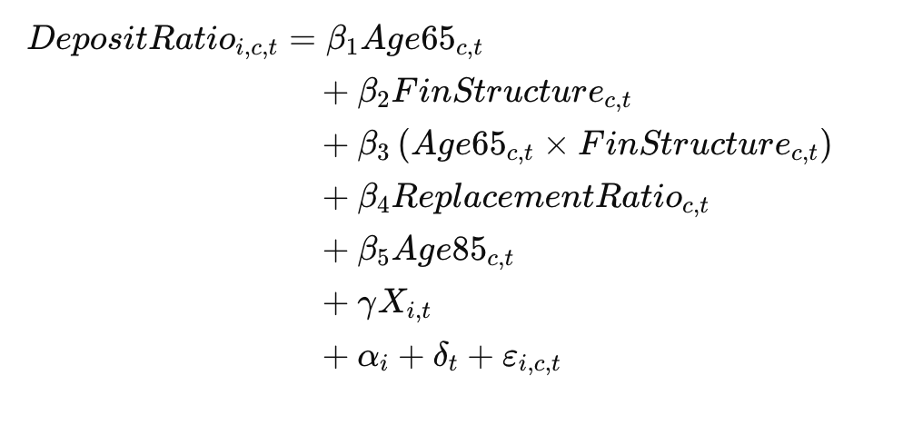
Revised: components of the refined regression model
Discussion
Regression component
Explanation
Baseline aging effect
Financial system structure effect
Aging effect depending on structure (interaction term)
Revised variable
Pension system control variable
Very old population effect
Bank-level control variables + Macro controls
Bank & year fixed effects; error term
Pension system controls:
-) Reclassification ratio
-) pension categories
-) death gap

Slide 16
Defining Europe
for the Research Dataset
Research Seminar Financial Institutions | Spring 2026
Prof. Dr. Emilia Garcia-Appendini | University of St.Gallen

Slide 17
Research Context
RQ: Does a higher share of retired people lead to lower retail deposit funding of savings banks, independently of pension system?
H1
Higher share of retired people
→ Lower retail deposit funding
H2
Wider "Death Gap" (Life exp. – Retirement age)
→ Higher deposits
Task: Define which countries in the S&P SNL dataset count as "European" – Switzerland must be included given its globally significant banking sector and unique multipillar pension system.
Dataset: S&P SNL Financial Institutions & Bank Data | 199 countries | FY2010–FY2025 | ~27,000 banks globally

Slide 18
Candidate Definitions of Europe
EU-27 + CH
28 countries
EU members + Switzerland. CH follows equiv. regulation. Globally significant banking sector. Full OECD data.
83,488 obs.
EEA + CH
31 countries
EU + NO, IS, LI + Switzerland. EU-equiv. financial regulation. Adds Nordic banks.
86,192 obs.
Eurozone
20 countries
Euro currency area. Common monetary policy. Too narrow—excludes CH, DK, SE, PL.
71,600 obs.
Geographic
55 countries
Broadest. Incl. UK, TR, RU, Balkans. Max sample but heterogeneous regulation.
104,848 obs.
✓ Recommendation: EU-27 + CH as primary sample, EEA + CH for robustness.

Slide 19
Population Aged 65+ in EU-27 + CH (2025)
EU-27 avg: 22.0% | CH: 19.5%
Source: Eurostat demo_pjanind (2025); BFS for CH

Slide 20
"Death Gap": Life Expectancy – Retirement Age (EU-27 + CH)
Death Gap = Life Expectancy at Birth – OECD Current Retirement Age (avg. M/F) | H2: Wider gap → higher deposits
Sources: Eurostat demo_mlexpec (2023); OECD Pensions at a Glance (2024)

Slide 21
Pension System Classification (EU-27 + CH)
Bismarckian
Earnings-related, contribution-based. Benefits proportional to past earnings. Dominant in Continental & Southern Europe.
17 countries
DE, FR, IT, AT, ES, PT, EL, BE, LU, PL, CZ, HU, SK, SI, HR, RO, BG
Beveridgean
Flat-rate, universal basic pension. Tax-funded. Dominant in Nordic & Anglo-Saxon countries.
5 countries
DK, FI, SE, NL, IE
Multipillar / Mixed
Combination of public mandatory + private funded pillars. Switzerland’s 3-pillar model is the archetype. Common in Baltic states.
6 countries
CH, EE, LV, LT, MT, CY
Classification: Ebbinghaus (2021); Werding (2003); OECD Pensions at a Glance (2024)

Slide 22
Key Takeaways
1
EU-27 + Switzerland recommended as primary Europe definition (28 countries, 83,488 obs.) – regulatory comparability and full demographic data coverage.
2
Population 65+ ranges from 15.2% (LU) to 24.7% (IT); CH at 19.5% – sufficient cross-country variation to test H1.
3
"Death Gap" ranges from ~11 to ~21 years; CH at 19.0 years – substantial variation across pension system types supports H2.
4
Pension systems: Bismarckian (17), Beveridgean (5), Multipillar incl. CH (6) – operationalised as dummies; retirement ages from OECD.
Datasets: OECD_Retirement_Age_2024 | Europe_Classification | Life_Expectancy | Death_Gap | Pop_65plus | Pension_System (all .csv)

Slide 23
Paper outline (TBD)
Motivation & research gap
Lifecycle theory (Modigliani and Brumberg, 1954): As households age, loan demand falls while demand for safe retirement assets rises, implying that aging can increase deposit-type savings and reduce borrowing
Market vs Bank based FS --> add theoretical background
Higher share of retired people --> higher deposit ratio --> add theoretical background
Hypotheses
H1: The positive effect of population aging on retail deposit funding is stronger in bank-based financial systems than in market-based financial systems
H2: TBD
Main regression model
Preliminary findings
XXX
Considerations
Potential omitted variable bias; multicollinearity, reverse causality

Slide 24
Research Seminar Financial Institutions Proposal
St.Gallen, 18th March 2026

Slide 25
Proposed slides for discussion with professor
Discussion
Comment NB: I would propose to leverage this document for the discussion with professor; it could be like a “mini-version” of our final paper but just in slides form only
Slide 1: Exec sum
Slide 2: Motivation & research gap
Slides 3 & 4: Hypotheses, economic intuition channels
Slide 5: Main regression model (its components)
Slide 6: Preliminary findings
Slide 7: Our key questions TBD with professor
Back-ups & annex
Slides with paper/literature overview; slides with datasets; slides arguing why to use certain ratios; OVB considerations

Slide 26
Questions (WIP)
Context: Unit is bank × year, and all regressors of interest (Age65, FinStructure, ARR, pension dummies) vary only at country × year. This means in regression, the standard errors must be clustered at the country level, because all banks within Germany in 2015 get the exact same Age65, FinStructure, and ARR values, so their residuals are mechanically correlated. With only 28 clusters this is a known small-cluster problem --> solution is wild cluster bootstrap. Question: is it fine or should we expand our country cluster?

Slide 27
FinStructure: Overview
FinStructure = ln [ (1 + Market Cap / GDP) / (1 + Private Credit by Banks / GDP) ]
Interpretation
Positive value → Market-based financial system (market cap > private credit) Negative value → Bank-based financial system (private credit > market cap)
Base (WB only)
22
252
−0.26
0.24
−1.18
0.41
Countries
Valid Obs.
Mean
Std Dev
Min
Max
Patched
27
366
−0.22
0.24
−1.18
0.41
Countries
Valid Obs.
Mean
Std Dev
Min
Max
Source: World Bank WDI, ECB SDW, BIS Total Credit Statistics, Nasdaq OMX Stockholm | Formula: Levine (2002)

Slide 28
FinStructure: Comparison vs. Levine (2002)
Strongly bank-based (< −0.2)
Market-based (> 0)
Mildly bank-based (0 to −0.2)
No data available
Country
Base
Patched
Levine
Country
Base
Patched
Levine
Cyprus
-0.782
-0.782
-1.11
Ireland
-0.209
-0.209
-0.03
Portugal
-0.567
-0.511
-7.52
Germany
-0.195
-0.195
-1.53
Estonia
N/A
-0.403
N/A
Hungary
-0.179
-0.179
N/A
Greece
-0.419
-0.419
-1.02
Croatia
-0.152
-0.152
N/A
Austria
-0.392
-0.392
-2.46
Romania
-0.150
-0.150
N/A
Italy
-0.431
-0.339
-1.45
Poland
-0.131
-0.131
N/A
Latvia
N/A
-0.336
N/A
France
-0.097
-0.080
-1.42
Slovak Republic
-0.331
-0.331
N/A
Luxembourg
-0.041
-0.041
N/A
Malta
-0.322
-0.322
N/A
Finland
N/A
-0.008
-1.29
Czechia
-0.304
-0.304
N/A
Belgium
0.053
0.013
-0.36
Slovenia
-0.283
-0.283
N/A
Netherlands
-0.115
0.036
-0.60
Spain
-0.280
-0.280
-1.29
Sweden
N/A
0.056
-0.15
Bulgaria
-0.263
-0.263
N/A
Switzerland
0.122
0.167
-0.71
Lithuania
N/A
-0.253
N/A
Denmark
N/A
N/A
-0.62
Structure Size from Levine (2002); N/A = not in Levine's original sample | Sorted by patched mean FinStructure

Slide 29
Aggregate Replacement Ratio: Overview
Definition: Gross median individual pension income of the population aged 65–74 relative to gross median individual earnings of the population aged 55–64, excluding other social benefits.
ARR = Median pension income (age 65–74) / Median earnings from work (age 55–64)
Rationale
Scharfstein (2018) documents that higher replacement rates are associated with more bank-based systems and greater household deposit holdings. Bottazzi, Jappelli & Padula (2006) show pension generosity substitutes for private wealth accumulation, supporting its use as a proxy for pension system generosity.
28
433
15
0.54
0.53
0.29
1.04
Countries
Total Obs.
NA's
Mean
Median
Min
Max
Coverage: EU-27 + Switzerland | 2010–2025 | 16 years per country | Full series sourced from Eurostat (tespm100)

Slide 30
Pension System Classification: Overview
Bismarckian
Beveridgean
Multipillar / Mixed
Earnings-related, contribution-based. Benefits proportional to past earnings. Dominant in Continental & Southern Europe.
Flat-rate, universal basic pension. Tax-funded. Dominant in Nordic & Anglo-Saxon countries.
Combination of public mandatory + private funded pillars. Switzerland's 3-pillar model is the archetype.
AUT, BEL, BGR, HRV, CZE, FRA, DEU, GRC, HUN, ITA, LUX, POL, PRT, ROU, SVK, SVN, ESP
DNK, FIN, IRL, NLD, SWE
CYP, EST, LVA, LTU, MLT, CHE
Dummy = 1 | 17 countries
Dummy = 1 | 5 countries
Baseline (both dummies = 0) | 6 countries
Source: Ebbinghaus (2021); Werding (2003); OECD Pensions at a Glance (2024)

Slide 31
Age65: Overview
Definition: Share of the total population aged 65 and above, expressed as a percentage of total population (World Bank, SP.POP.65UP.TO.ZS).
Rationale: Following Doerr, Kabaš & Ongena (2024) and Avramidis & Pennacchi (2025), the 65+ threshold most robustly captures the relationship between demographic aging and bank retail deposit funding.
28
420
28
18.71
19.01
11.32
24.62
Countries
Valid Obs.
NA's
Mean
Median
Min
Max
Coverage: All 28 countries (EU27 + CH) have exactly 15 valid observations (2010–2024). 2025 missing for all countries — not yet reported by World Bank.
Source: World Bank WDI (SP.POP.65UP.TO.ZS) | Period: 2010–2024 | EU-27 + Switzerland

Slide 32
Research Seminar Financial Institutions Descriptive Statistics
St.Gallen, 18th March 2026

Slide 33
Step 1 - SNL Dataset: banks for EU27 + CH
1
Full Dataset
2
By Bank Type
3
Savings Banks
All bank types · 28 countries
3 categories breakdown
Deep-dive · 26 countries
5,218
2,569
41,104
26/28
Banks
Unique banks
Observations
Countries
Entity IDs
16.0 obs / bank
LT, RO absent
83,488
Observations by country (top 10 of 26)
Observations
16 yrs
›
›
Time span
28
Share of total obs:
Countries
19.6% Other Banking
31.2% Bank
49.2% Savings Bank
⚠ Germany = 46% of obs · robustness check planned (excl. DE)

Slide 34
Step 2 - Dataset: data filtering & missingness
Fix layout
Sample Construction
Missingness Assessment
Full dataset
83,488
✓ Zero missingness in all core variables
Deposit Ratio · Total Deposits · Total Assets · Age65 · Pension dummies · ARR (4 missing, negligible)
5,218 banks · 28 countries
▼
FinStructure — only meaningful gaps
Savings banks only
41,104
FinStructure
1,533 obs (4.9%)
2,569 banks · 26 countries
Market cap / GDP
734 obs (2.3%)
▼
Private credit / GDP
800 obs (2.5%)
Deposit Ratio filtered
31,439
Drops FY2025, and NAs in previous years
Components are not independent — same country-year obs drive all three gaps.
2,569 banks · 26 countries
Analytical Sample by Specification
Specification
Obs
Banks
Countries
Model 1 — no FinStructure
31,439
2,569
26
Models 2–5 — FinStructure
29,906
2,484
25
Δ attrition
−1,533
−85
−1

Slide 35
Step 2 - Dataset: key flags & commentary
Fix layout
Pattern 1 — Early-year gaps in smaller Eastern European markets
Czechia (FY2010–2017) · Slovakia (FY2015–2022) · Bulgaria (FY2012–2017) · Croatia (FY2010–2012)
Thin or undeveloped stock markets in the early post-GFC period — World Bank market cap data unavailable. Impact is minimal given small country sample sizes.
Pattern 2 — Structural gaps in larger markets
Denmark: all 15 years, 652 obs — drops entirely from Models 2–5. Beveridgean group shrinks 5 → 4 countries (loses DK, retains FI, SE, NL, IE) in all specifications including FinStructure.
Easy to find DE
Germany: FY2024 only (795 obs) — negligible given 15,292 total German observations. Caused by delayed World Bank data publication.
Attrition moving from Model 1 → Models 2–5 is entirely attributable to FinStructure gaps: Denmark (652), Germany FY2024 (795), minor Eastern European gaps. Non-random — will be noted explicitly in the data section.
⚑ Flag for professor discussion
Denmark's complete absence from FinStructure specifications should be raised explicitly. It is the only fully missing Beveridgean country, which could affect the precision of pension system interaction estimates.
Potential remedy: source Danish stock market capitalisation data from Nasdaq OMX Copenhagen or the Danish central bank — worth discussing before finalising the dataset.

Slide 36
Step 3: Variance decomposition - within vs. between Do key regressors move enough over time to survive fixed effects? All SDs computed on analytical sample (n = 31,439)
Fix layout
Variable
Overall SD
Between SD
Within SD
Within / Between
Deposit Ratio
Mostly cross-sectional — funding models stable YoY. Within SD still exploitable.
0.136
0.127
0.047
0.371
Age65 (%)
Best result. Aging moves meaningfully within countries — FE identification validated.
1.737
1.411
1.013
0.718
FinStructure
Weakest FE identification. Post-GFC convergence argument holds, but expect wider SEs on β₃.
0.175
0.200
0.072
0.359
Replacement Ratio (ARR)
Decent within-variation — pension reforms shifted ARR across 2010–2024.
0.075
0.067
0.033
0.498
Takeaway No red flags — all variables have exploitable within-variation for FE estimation. Age65 is best-identified (0.718). FinStructure is weakest (0.359) — flag this honestly and connect to the post-GFC convergence argument in your methodology section.
Source: SNL Financial · World Bank WDI · Analytical sample: n = 31,439

Slide 37
Step 4a: Descriptive statistics
Fix layout
Analytical sample · Savings banks only · n = 31,439 obs · 2,569 banks · 26 countries
Variable
N
Mean
SD
Min
Median
Max
Note
Deposit Ratio
31,439
0.732
0.136
0.000
0.762
0.983
73% of assets funded via deposits — as expected for retail savings banks
Age65 (%)
31,438
20.6
1.74
11.3
20.8
24.6
Wide cross-country range. Within-variation (0.718) validates FE strategy ✓
FinStructure
29,906
−0.211
0.175
−1.18
−0.207
+0.408
Negative mean → sample is bank-based (Continental Europe). Weakest within-variation (0.359) — flag in methodology
ARR
31,435
0.541
0.075
0.29
0.510
1.04
54% avg. replacement rate. Post-GFC pension reforms drive within-variation (0.498)
Bismarckian (dummy)
31,439
0.825
0.380
0
1
1
82.5% of obs — reflects Germany’s dominance (~49%). Structural, not sampling artifact
Beveridgean (dummy)
31,439
0.105
0.307
0
0
1
10.5% of obs. Denmark absent from Models 2–5 — flag as limitation
Baseline category (both dummies = 0): Multipillar/Mixed — dominated by Switzerland (2,107 obs vs. Estonia 7, Latvia 4, Cyprus 22, Malta 49). Consider recoding baseline to Beveridgean for easier economic interpretation — raise with professor.

Slide 38
Step 4b: Descriptive statistics by financial system type
Fix layout
Motivation for H1 · Split at FinStructure = 0 · Analytical sample (excl. missing FinStructure)
Bank-based
Market-based
Variable
Bank-based
(n=26,540 · 25 countries)
Market-based
(n=3,366 · 7 countries)
Comment
0.730
0.738
∆ +0.8 pp
Deposit Ratio
Market-based slightly higher — raw unconditional mean. H1 is about the aging interaction, not the level. Regression required.
20.7%
19.6%
∆ −1.1 pp
Age65 (%)
Bank-based countries are older on avg. ⇒ aging & FinStructure correlated in cross-section. Watch for multicollinearity.
−0.255
+0.136
Split clean
FinStructure
Binary classification at zero is meaningful — not driven by borderline cases.
0.549
0.507
∆ −4.2 pp
ARR
Bank-based systems have more generous pensions (Bismarckian link). Watch ARR–FinStructure correlation in VIF diagnostics.
⚠️ 88% of obs are bank-based — market-based group (7 countries) is thin → wider SEs on market-based estimates.
Takeaway No level difference in deposit ratios — this is exactly why the regression is necessary. H1 tests the aging–FinStructure interaction, which is invisible in unconditional means.

Slide 39
Step 4c: Correlation matrix, key regressors
Fix layout
Analytical sample · Pearson correlations · Pairwise complete observations
Dep. Ratio
Age65
FinStr.
ARR
Bismarck.
Beveridg.
Dep. Ratio
—
Key Findings
Bismarck. × FinStr. − 0.680
Age65
-0.060
—
High collinearity — both capture the same Continental European institutional reality. Interpret in isolation with caution.
FinStr.
0.000
0.022
—
ARR × FinStr. − 0.421
Moderate collinearity — bank-based countries have more generous pensions (Scharfstein 2018). Run VIF after Model 3.
ARR
-0.170
0.037
-0.421
—
Beveridg. × Bismarck. − 0.745
Mechanical by construction (mutually exclusive dummies). Not a concern.
Bismarck.
-0.052
0.336
-0.680
0.247
—
Age65 × FinStr. +0.022
Beveridg.
-0.002
-0.104
0.362
-0.085
-0.745
—
Near zero — older countries are not systematically more bank-based. Interaction term β₃ is cleanly identified.
ARR × Age65 +0.037
Takeaway Age65×FinStructure ≈ 0 — interaction term well-identified. Flag ARR–FinStructure (−0.421) and Bismarckian–FinStructure (−0.680) collinearity. Report VIF after Model 3.
Near zero — older countries do not have more generous pensions in this sample. Clean.

Slide 40
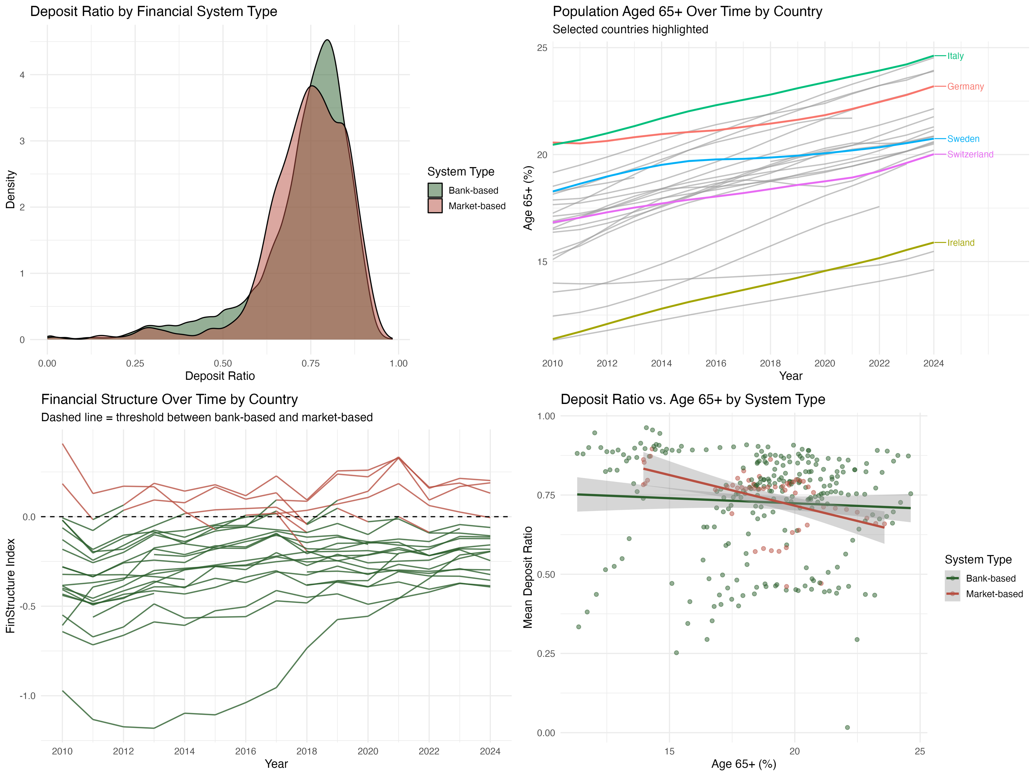
Step 4d: Descriptive plots
Fix layout

Slide 41
Step 4d: Descriptive plots, commentary
1
Deposit Ratio by Financial System Type
2
Population Aged 65+ Over Time
Both distributions peak around 0.75–0.80 — virtually identical in shape and location. Unconditionally, financial system type does not differentiate deposit ratios. This is the key motivating argument: the system effect only surfaces when interacted with aging. A simple level comparison is insufficient; your interaction design is necessary.
All countries trend upward monotonically — aging is universal and consistent across the sample. Meaningful cross-country dispersion persists throughout: Italy reaches ~25% by 2024, Ireland stays below 16%. The unlabeled countries cluster tightly in 18–22%, confirming highlighted countries capture the extremes. Clean variable, no anomalies.
3
Financial Structure Over Time
4
Deposit Ratio vs. Age65+ by System Type
Bank-based (green) vs. market-based (red) separation is clean — the binary classification is meaningful. Green lines drift upward post-GFC — bank-based countries gradually becoming less bank-based, directly evidencing within-country FinStructure variation under fixed effects. Note: the highly volatile line at the bottom is Cyprus (2012–13 banking crisis) — worth a footnote.
Deposit ratios decline with aging in both system types — but the decline is steeper in market-based systems. This reflects two competing theoretical forces:
Layer 1: Lifecycle spending effect: Elderly households are net dissavers, drawing down deposits to fund retirement consumption. This pushes deposit ratios down in both systems.
Layer 2: Safe asset reallocation effect: Simultaneously, aging households become more risk averse and shift wealth from risky assets into safe liquid instruments. In bank-based systems deposits are the natural destination, partially offsetting Layer 1 and flattening the slope. In market-based systems, bonds and money market funds serve as substitutes, so this offsetting effect is weaker and the decline is steeper.
This two-layer mechanism is the theoretical core of H1 and constitutes preliminary descriptive evidence for the interaction effect.
Source: SNL Financial · World Bank WDI · Eurostat · Analytical sample: n = 31,439

Slide 42
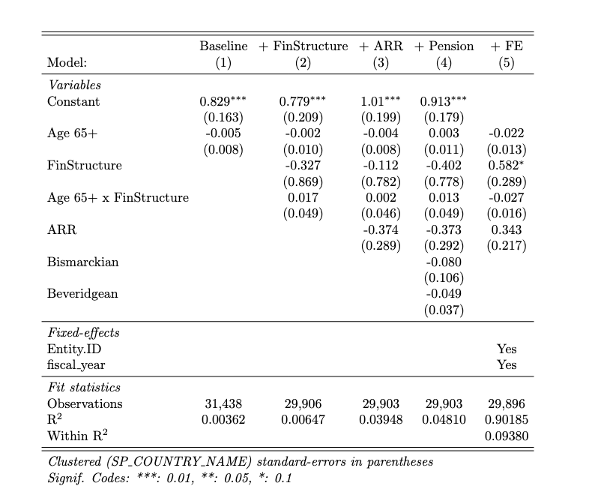
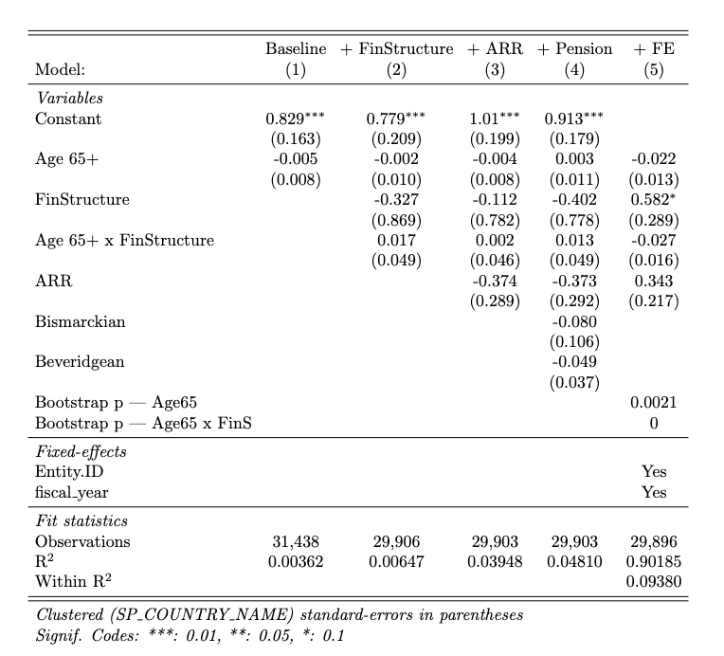
Regression output: preliminary findings
Regression output: country-level clustering
Robustness: wild-boostrapping

